Slide 1
Welcome!
Question of the Day:
‹#›

Slide 2
7.7 Benford’s Law
PROFESSOR RAMSEY
GDC 6.318
ramsey@cs.utexas.edu
Notes:
Benford isn’t a 2D Arrayt

Slide 3
Announcements
TBD

Slide 4
Unit 2 Test Info
The test focuses on Chapters 3G - 7. Understanding of material previously covered in Chapters 1 - 3 is necessary, but not the focus.
* There is an extra time test and a make-up test for students who have been approved ahead of time. There is also an alternate test time for students with a UT testing conflict and who have been approved ahead of time. The day, time and location of these tests will be emailed to the approved students.

Slide 5
Quiz

Slide 6
Manual Tallies
Given an integer, count how many of each digit. For the integer 26067266:
0 4 8
1 5 9
2 6
3 7

Slide 7
Tally Code Options
Option 1 - Have variables like num0s, num1s, num2s… This requires a lot of code and isn’t efficient.
Option 2 - Use the digit as the array index. For the same number 26067266:
index | 0 | 1 | 2 | 3 | 4 | 5 | 6 | 7 | 8 | 9
value | 1 | 0 | 2 | 0 | 0 | 0 | 4 | 1 | 0 | 0

Slide 8
Demo
Demo 1
Write digitTallies().

Slide 9
Design

Slide 10
Solution

Slide 11
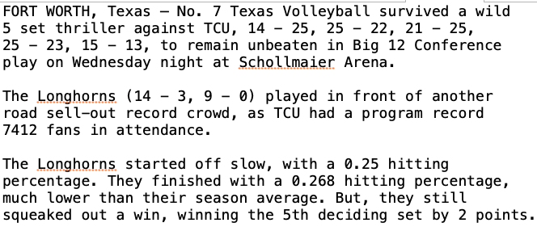
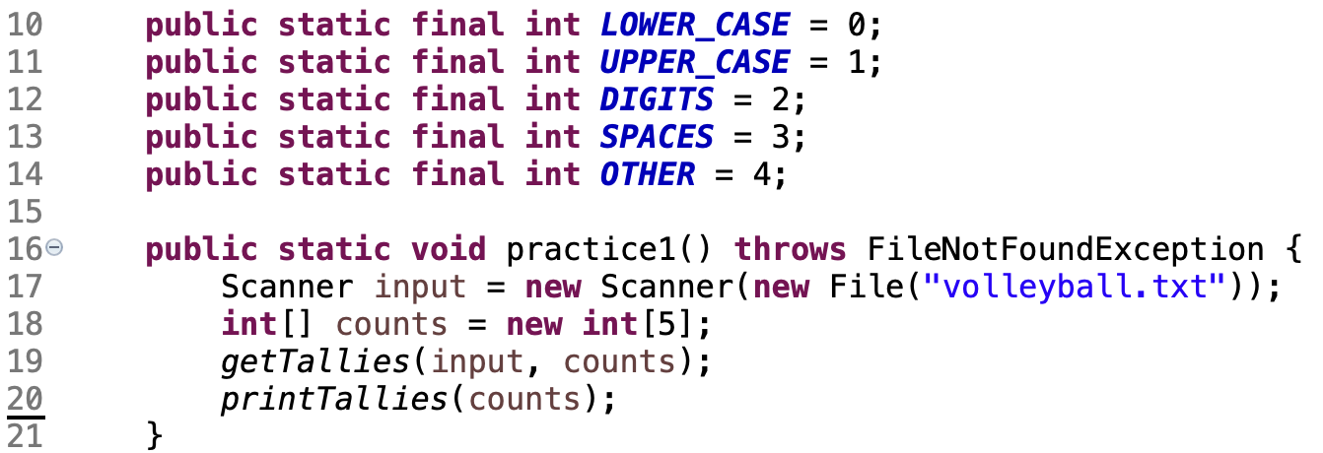
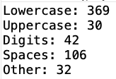
getCharTallies()
Read a file and print the number uppercase, lowercase, digit, space and other characters.
In-Class Practice
Input:
Output:
Calling code:

Slide 12
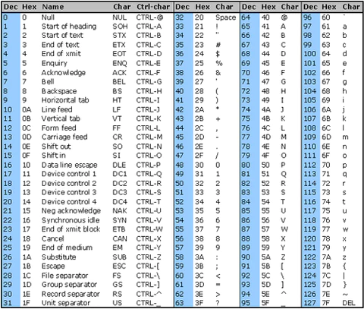
ASCII Table

Slide 13
Design

Slide 14
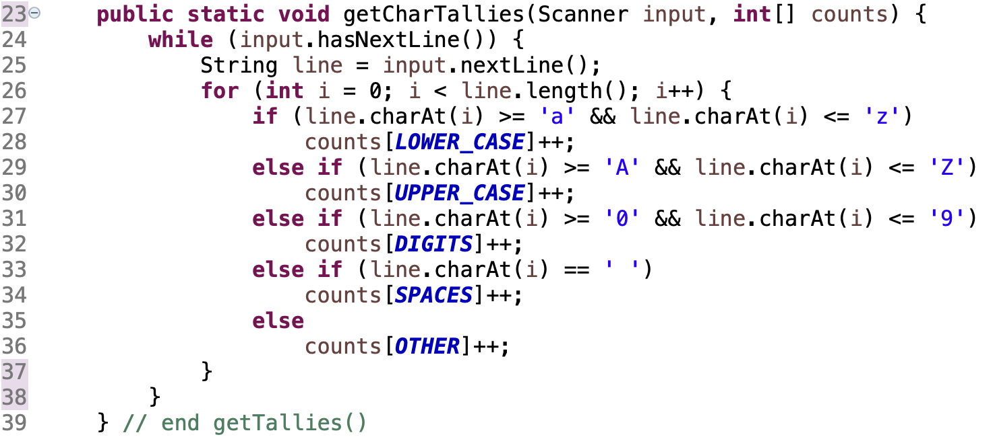
Solution

Slide 15
STOPPED HERE

Slide 16
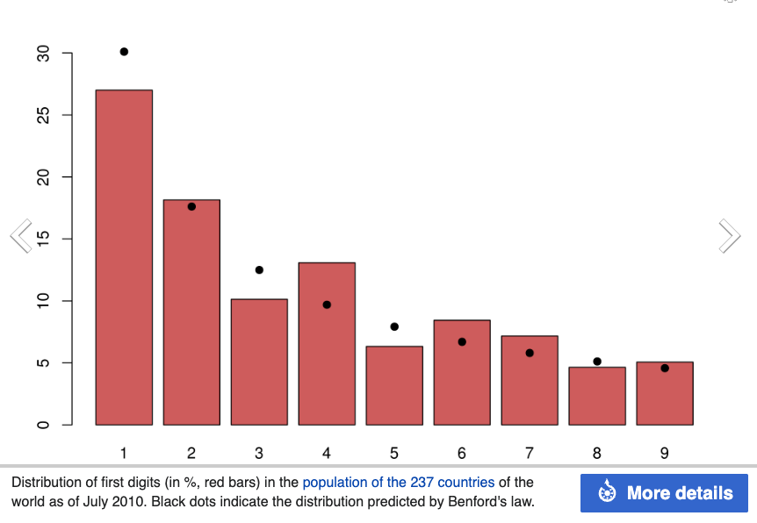
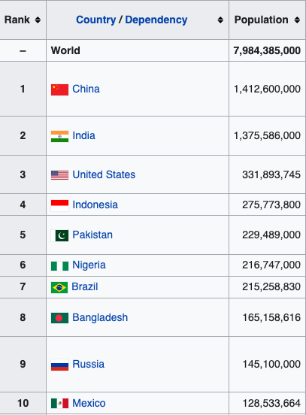
Benford’s Law Example
An observation that in many real-life sets of numerical data, the leading digit is likely to be small. For example, nearly 30% of the numbers will begin with ‘1’.
https://en.wikipedia.org/wiki/Benford%27s_law#Examples

Slide 17
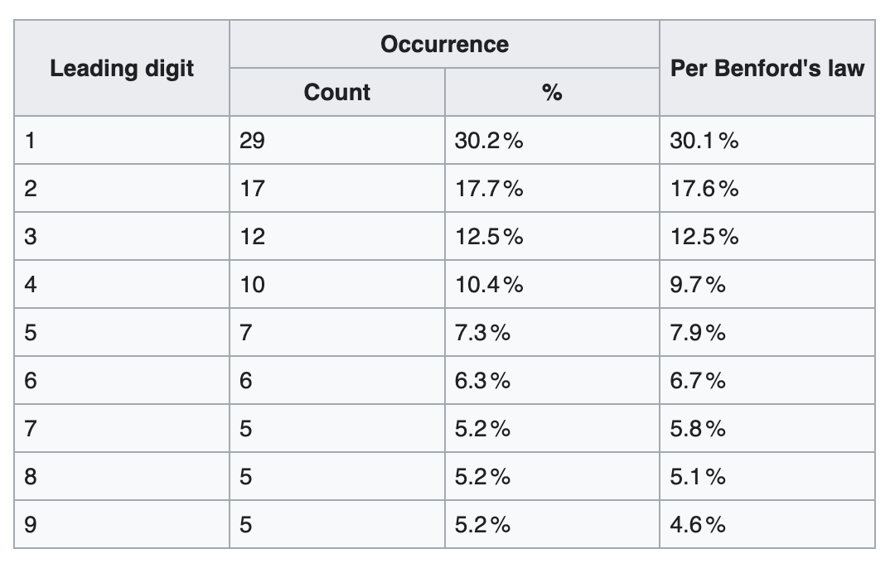
Benford’s Law Example 1
Leading digit of 2^{n}
https://en.wikipedia.org/wiki/Benford%27s_law#Examples

Slide 18
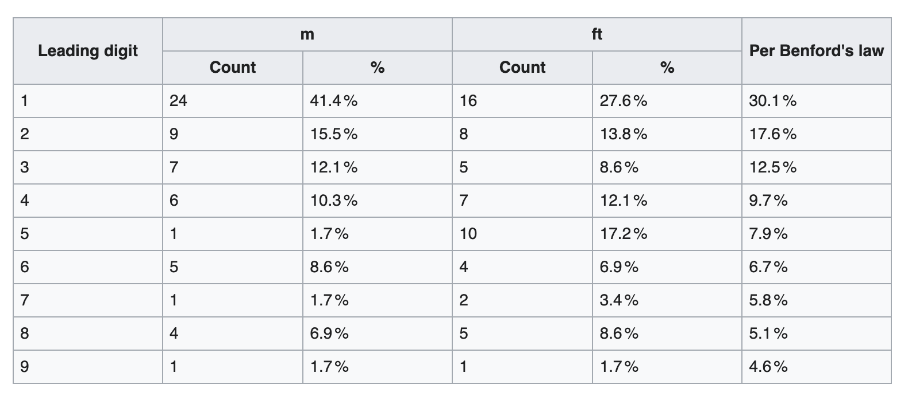
Benford’s Law Example 2
The height of the 58 tallest buildings
https://en.wikipedia.org/wiki/Benford%27s_law#Examples
https://en.wikipedia.org/wiki/Benford%27s_law#Examples

Slide 19
What Kinds of data?
Examples of Benford’s Law
Street addresses
Stock prices
Population counts
Length of rivers
NOT examples of Benford’s Law
Results of rolling one dice
Zip codes
More info
Works for all number bases
Works to a lesser degree for 2nd, 3rd, etc. digits
Questions?

Slide 20
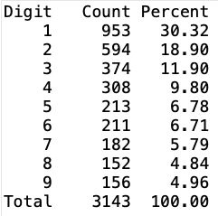
In-Class Practice
Input Output
Benford.java
Write countLeadingDigits(). Use main() and getFirstDigit().

Slide 21
Remember
You Belong Here
Hi!

